Slide 1
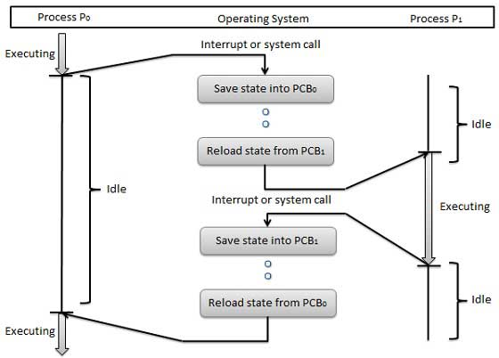
Context Switching: It means switching of CPU from one process to another process
saving the state of old process and loading the state of new process
while process P0 is executing,os sends an interupt signal then CPU stops the execution of process P0. os save the state into PCB0 and reload the process from PCB1
while process P1 is executing if os sends an interupt signal then CPU stops the execution of process P1. os save the state into PCB1. and reload the process P0 from PCB0

Slide 2
Dispatcher: This is a module that gives control of the CPU to the process which is selected by S.T.S
Dispatche Latency:The time taken by the dispatcher to stop process and start another process for execution is known as dispatcher latency.
Non-Preemptive scheduling: In this method if the process is running in CPU any higpriority process come for execution it will not stop the current process until its complete the execution.
Preemptive scheduling: In this method if the process is running in CPU any high priority process come for execution CPU stop the current process execution and execute the high priority process.
O.S scheduling criteria:
CPU utilization: How long CPU is busy.
Throughput: no of processes executed in unit of time
Burst time/execution time: the amount of cpu time the process require to complete its execution
Arrival time: Time which process available in ready queue.
Turn around time: completion time-arrival time
waiting time: t.a.t-b.t
Response time: After begining of execution time to get the first response.

Slide 3
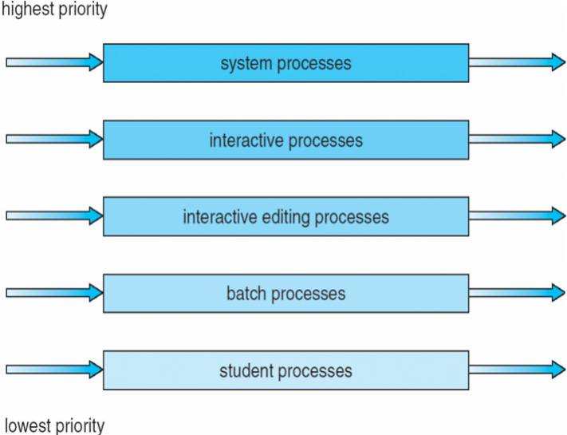
Multilevel queue scheduling:
In multilevel queue scheduling algorithm partition the ready queue into multiple ready queues.
Process is stored in the ready queue based on the process property(cpu b.t,priority etc)
in order to use the os, we required some processes. so all those processes are stored in system processes.
Process response time is very less in interactive(fore ground)
Process response time is very high in batch(back ground)
if we develop any program that is student processes.

Slide 4
each ready queue has its own scheduling algorithm
how we can perform the scheduling b/w different queues for that we will use
a)fixed preemptive priority scheduling
b)time slice b/w queues
if we exeute the student process all above process are empty then only student process executed. so starvation problem occurs here
to overcome this problem use the time slicing.
time slice give to each ready queue.
80% to foreground in RR and 20% to background in FCFS

Slide 5
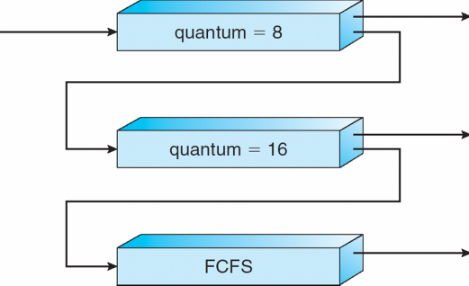
Multilevel feedback queue:
first CPU executes the Q0 . once all execution done in Q0 then starts the Q1 and Q2 executed after completion of Q0 and Q1
if the process b.t>8ms that process moved to Q1
if the process b.t>16ms that process moved to Q2
if the process is waiting for long amount of time that process moved to its high priority queue (avoid starvation)
process b.t is small we can place in high priority queue. b.t is more place in low priority queue.

